Slide 1
VOLLEYBALL
SCORESHEET INSTRUCTIONS
Volleyball Australia 12-Substitution version
press space bar
Version 2
May 2024
Edited by M. Mansfield
Bendigo Volleyball Association

Slide 2
12-Substitution Scoresheet instructions
NB: This exercise is for an UN-TIMED match, with 3 minutes between each set
1. Before the match
3. During the match
4. After the match
- The Team List
- Scoring
- The Officials
- Substitutions
5. Remarks section
2. After the coin toss
- Time-Outs
- Before the start of the set
- End of set
6. Special circumstances
- Starting Rotations
- The deciding set
- Forfeit of a set
- First Servers
- Misconduct sanctions
- Delay sanctions
Click on a section or press space bar

Slide 3
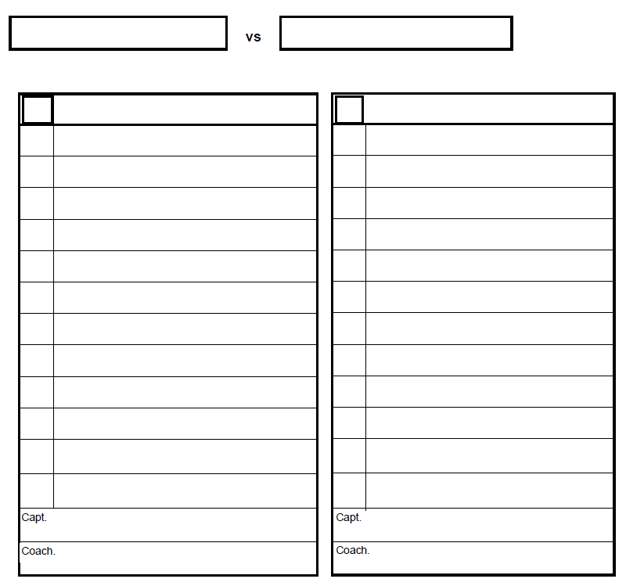
1. BEFORE THE MATCH – The Team List
Name of the teams.
Bendigo
Horsham
Name of players.
R
,
.
Bendigo
Horsham
eynolds
G
1
1
Mitchell, A.
Reynolds, G.
2
Dent, A.
3
Larkins, A
First letter of the name in upper case
The rest of the name in lower case
Initials in upper case
3
Holmes, S.
5
Hansen, D
4
Saunders, C.
6
Chen, V.
6
Fletcher, J.
7
Monson, R.
Player numbers.
7
Kramer, J.
8
Wynter, L.
Coach signature.
9
Nunez, M.
9
Colling, C.
10
Boyd, P.
13
Watson, S.
11
Case, E.
15
Robertson, K.
12
Harris, B.

Slide 4
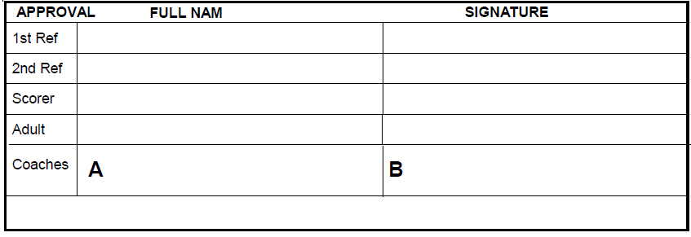
1. BEFORE THE MATCH – The Officials
In the APPROVAL section on the bottom of the scoresheet.
Referees, and scorer
in the same format as the team list.
Chugg, L.
Han, R.
Magrath, C.
Tucker, L.
Captains

Slide 5
1. BEFORE THE MATCH – The Officials
2. AFTER THE COIN TOSS
From the teams’ captains:
Pre-match signature
B
Bendigo
A
Horsham
1
Reynolds, G.
1
Mitchell, A.
From the 2nd referee:
2
Dent, A.
3
Larkins, A
3
Holmes, D.
5
Hansen, D
The team playing on your left side (to be designated team A)
Team B is the team playing on your right side
4
Saunders, C.
6
Chen, V.
6
Fletcher, J.
7
Monson, R.
7
Kramer, J.
8
Wynter, L.
9
Nunez, M.
9
Colling, C.
10
Boyd, P.
13
Watson, S.
11
Case, E.
15
Robertson, K.
12
Harris, B.

Slide 6
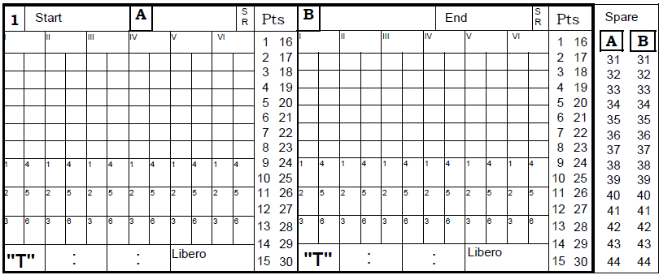
2. AFTER THE COIN TOSS – Before the start of the set
Write down the teams on their corresponding sides.
Horsham
Bendigo
Mark the team serving first.
Then mark the team receving first.

Slide 7
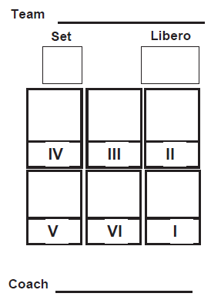
2. AFTER THE COIN TOSS – Starting Rotations
2. AFTER THE COIN TOSS – Before the start of the set
The coach of each team will give you a rotation slip:
Horsham
Horsham
Bendigo
1
10
5
3
7
1
9
15
1
7
3
9
15
5
Player #5 is starting in position one
Player #3 is starting in position two
And so on...
10
Don’t forget the Libero!

Slide 8
2. AFTER THE COIN TOSS – First Servers
2. AFTER THE COIN TOSS – Starting Rotations
The first server for Team A is player #5.
Horsham
Bendigo
Mark the small 1 in the box under player #5 to confirm that they are the correct server
5
3
7
1
9
15
9
6
12
2
11
4
Team B is receiving first. Their first server is player #6 in position II, NOT player #9.
Cross the box with the small 1 under player #9 to confirm that they are NOT serving first.
10
1

Slide 9
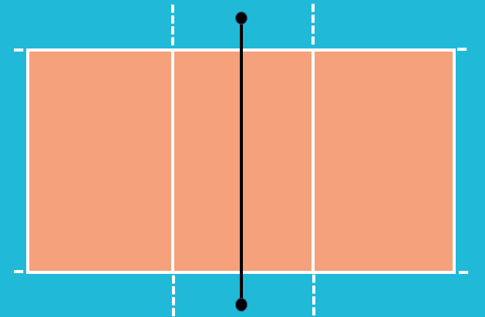


3. DURING THE MATCH – Scoring
2. AFTER THE COIN TOSS
Horsham
Bendigo
Point!
Point!
9
1
6
9
03
00
02
04
01
00
01
03
02
15
7
12
4
5
3
2
11
Horsham has won the rally.
Horsham has lost the serve.
The 1st Referee has blown the whistle to start the match.
Cross off every point won.
9:00
Horsham
Bendigo
Record the current score of that team in the relevant service order box
5
3
7
1
9
15
9
6
12
2
11
4
Record the match start time.
Bendigo players rotate one position.
2
3
1
3
Score a point for Bendigo and tick off the service box under the next server.
10
1

Slide 10
3. DURING THE MATCH – Scoring
3. DURING THE MATCH – Substitutions
Horsham
Bendigo
12
15
9
6
9
11
5
1
12
4
SUB!
8
2
11
3
7
Horsham has called for a substitution.
9:00
Horsham
Bendigo
5
3
7
1
9
15
9
6
12
2
11
4
Player #8 is coming on for Player #3.
8
Write ‘08’ under Player #3. Player #8 is now serving.
2
3
4
5
8
9
1
3
5
8
9
11
11
10
1

Slide 11
3. DURING THE MATCH – Substitutions
Horsham
Bendigo
3
5
2
12
18
8
13
7
15
11
6
SUB!
1
9
4
9
Later in the set, Horsham calls for another substitution.
9:00
Horsham
Bendigo
5
3
7
1
9
15
9
6
12
2
11
4
Player #3 is coming back for Player #8.
8
3
8
This is Player #3’s third and last entry, they will not be allowed back on court if they are substituted again.
3
2
3
4
5
8
9
1
3
5
8
9
11
13
16
11
12
13
Circle the player’s third entry.
10
1

Slide 12
3. DURING THE MATCH – time-outs
3. DURING THE MATCH – Substitutions
Horsham
Bendigo
TIME-OUT!
18
3
5
2
12
13
7
15
11
6
1
9
4
9
Bendigo has called a
time-out.
9:00
Horsham
Bendigo
5
3
7
1
9
15
9
6
12
2
11
4
Record the score of both teams.
8
3
8
First record the score of the team that called the time-out, then the other team’s score.
3
2
3
4
5
8
9
1
3
5
8
9
11
13
16
11
12
13
10
13 18
1

Slide 13
3. DURING THE MATCH – time-outs
3. DURING THE MATCH – End of set
Horsham
Bendigo
25
9
1
6
9
22
15
7
12
4
5
3
2
11
The 1st Referee has blown the whistle to end the set.
9:00
Horsham
Bendigo
9:24
Record the set end time.
5
3
7
1
9
15
9
6
12
2
11
4
Circle the score corresponding to each team’s last service order box, regardless if they served.
8
3
8
3
2
3
4
5
8
9
1
3
5
8
9
In the points sections, cancel all points not marked off
11
13
16
18
20
22
11
12
13
14
17
18
25
22
10
13 18
1

Slide 14
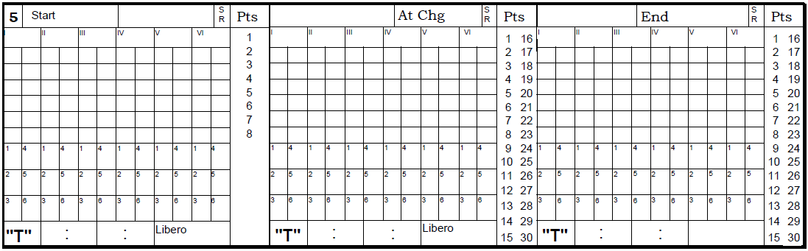
3. DURING THE MATCH – The deciding set
3. DURING THE MATCH – End of set
Horsham
Bendigo
The last set of an untimed match is played to 15.
00
1
6
9
2
00
Teams switch courts when either team reaches 8 points.
8
7
3
4
5
13
11
10
The 1st and 2nd Referees will do another coin toss.

Slide 15
3. DURING THE MATCH – The deciding set
Horsham
Bendigo
The last set of an untimed match is played to 15.
1
6
9
2
00
Write down the teams on their corresponding sides.
00
Teams switch courts when either team reaches 8 points.
8
7
3
4
Mark the serving and receiving team.
5
13
11
10
The 1st and 2nd Referees will do another coin toss.
Copy the team name over.
Horsham
Bendigo
Horsham

Slide 16
3. DURING THE MATCH – The deciding set
Horsham
Bendigo
Write down the starting rotations.
00
1
6
9
2
00
Copy left team’s starting rotation.
8
7
3
4
5
13
11
10
Scoring continues as normal.
Horsham
Bendigo
Horsham
5
13
7
6
1
8
2
9
3
11
10
4
5
13
7
6
1
8

Slide 17
3. DURING THE MATCH – The deciding set
Horsham
Bendigo
Bendigo
Horsham
Bendigo has reached 8 points.
5
1
13
2
10
11
06
9
15
08
08
06
The 1st Referee blows the whistle for teams to switch courts.
7
8
8
7
3
4
4
3
1
5
11
15
2
13
10
9
10:37
Horsham
Bendigo
Horsham
5
13
7
6
15
8
2
9
3
11
10
4
5
13
7
6
15
8
1
1
2
6
3
5
6
2 6

Slide 18
3. DURING THE MATCH – The deciding set
Bendigo
Horsham
Write down Bendigo’s score at the time of change of courts.
08
9
2
15
1
06
3
4
8
7
Copy over Horsham’s time-outs and substitutions.
11
10
5
13
Cancel all of the points already scored.
10:37
Horsham
Bendigo
8
Horsham
5
13
7
6
15
8
2
9
3
11
10
4
5
13
7
6
15
8
1
1
1
2
6
3
5
6
2 6
2 6

Slide 19
3. DURING THE MATCH – The deciding set
Bendigo
Horsham
Point!
9
2
15
1
Point!
09
08
08
07
06
Scoring for Horsham continues on the right side
3
4
8
7
11
10
5
13
10:37
Horsham
Bendigo
8
Horsham
5
13
7
6
15
8
2
9
3
11
10
4
5
13
7
6
15
8
1
1
1
2
6
3
5
6
8
9
7
2 6
2 6

Slide 20
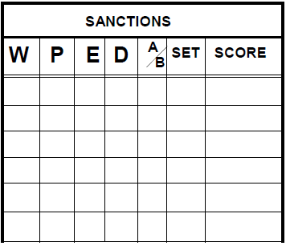
3. DURING THE MATCH – Substitutions
3. DURING THE MATCH – Misconduct sanctions
Horsham
Bendigo
12
15
9
6
9
11
5
1
12
4
Yellow card for Coach Team A
3
7
2
11
9:00
Horsham
Bendigo
3
9
6
12
A yellow card is a formal warning.
5
7
1
9
15
2
11
4
C
A
1
12:11
Record it in the ‘Sanctions’ section of the scoresheet, under the ‘W’ column.
5
‘C’ for Coach
‘A’ for Team A
The set number
The score. The team sanctioned goes first.
2
3
4
8
9
1
3
5
8
9
11
11
10
1

Slide 21
3. DURING THE MATCH – Misconduct sanctions
Horsham
Bendigo
12
15
9
6
9
11
13
5
1
12
4
Red Card for player #2 Team B
3
7
2
11
9:00
Horsham
Bendigo
5
3
7
1
9
15
9
6
12
2
11
4
A red card is a penalty.
The team receiving the red card loses the serve, and a point is awarded to the other team.
Record it in the ‘Sanctions’ section of the scoresheet, under the ‘P’ column.
C
A
1
12:11
2
B
1
11:12
‘2’ for the player number
‘B’ for Team B
The set number
The score. The team sanctioned goes first.
Circle the point awarded by the sanction.
2
3
4
5
8
9
1
3
5
8
9
11
11
10
1

Slide 22
3. DURING THE MATCH – delay warnings
3. DURING THE MATCH – misconduct sanctions
Horsham
Bendigo
3
5
11
2
14
18
13
7
15
4
12
Delay warning for Team A
1
9
Delay Penalty for Team A
9
6
9:00
Horsham
Bendigo
5
3
7
1
9
15
9
6
12
2
11
4
The team receiving the delay penalty loses the serve, and a point is awarded to the other team.
A delay penalty is recorded under the ‘P’ column.
A delay warning is recorded under the ‘W’ column.
C
A
1
12:11
‘D’ for Delay. Delay sanctions are given to teams, not individual players.
2
B
1
11:12
D
A
1
13:18
Circle the point awarded by the sanction.
5
D
A
1
18:13
5
2
3
4
8
9
1
3
8
9
11
13
16
18
11
12
13
10
13 18
1

Slide 23

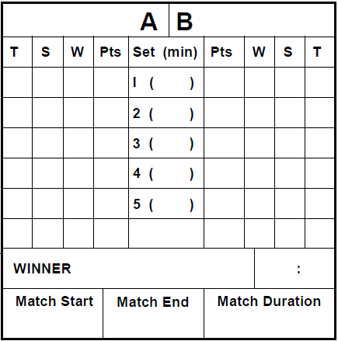
3. DURING THE MATCH – delay warnings
4. AFTER THE MATCH
Record the results of each set in the ‘Results’ section.
Horsham
Bendigo
T = Time-outs
S = Substitutions
W = Set Won (recorded 1 for win, 0 for lost
Pts = Points
Set (min) = Set duration in minutes
0 4 1 25 24 22 0 1 1
2 2 0 19 21 25 1 2 1
1 2 1 25 22 20 0 0 2
2 2 0 23 25 25 1 2 0
2 2 0 11 18 15 1 1 2
7 12 2 103 110 107 3 6 6
The sum totals go on the bottom.
Bendigo
3 2
The winner of the match.
The final set score.
9:00 11:02 2h 02m
Match start, end, and duration. NB: The total time of all sets, plus the total intervals between sets (4 x 3mins =12) MUST equal the match duration.

Slide 24
4. AFTER THE MATCH
The officials and each team captain sign to confirm the results.
Chugg, L.
Jianguo, K.
Magrath, C.
Tucker, L.
The team captains sign at the end of the match
Captains

Slide 25
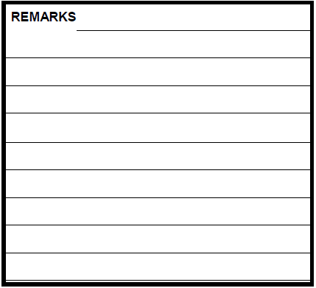


5. REMARKS SECTION
4. AFTER THE MATCH
Injuries, delayed match start time, and forfeits are recorded as remarks.
Remarks need to be recorded with this level of information:
Match start time delayed by 14 minutes due to previous game going over time.
W
hen
W
ho
Set 1, Bendigo forfeited due to no show.
hat
W
3rd set 14:17, Player #1 Team A authorized for medical time-out. Duration: 2 minutes.

Slide 26
5. REMARKS SECTION
6. SPECIAL CIRCUMSTANCES – Forfeit of a set
If a team forfeits a set, complete each set on the scoresheet as follows:
9:00
Horsham
Bendigo
9:05
By default, the complete team is declared Team A and is awarded the serve.
Rotations are left blank for both teams.
Start time as protocol intended, end time is the time the set is officially declared forfeited.
25
0
Fill out the points as 25-0.

Slide 27
Good Luck!
Click here to go back to the content page

